Slide 1
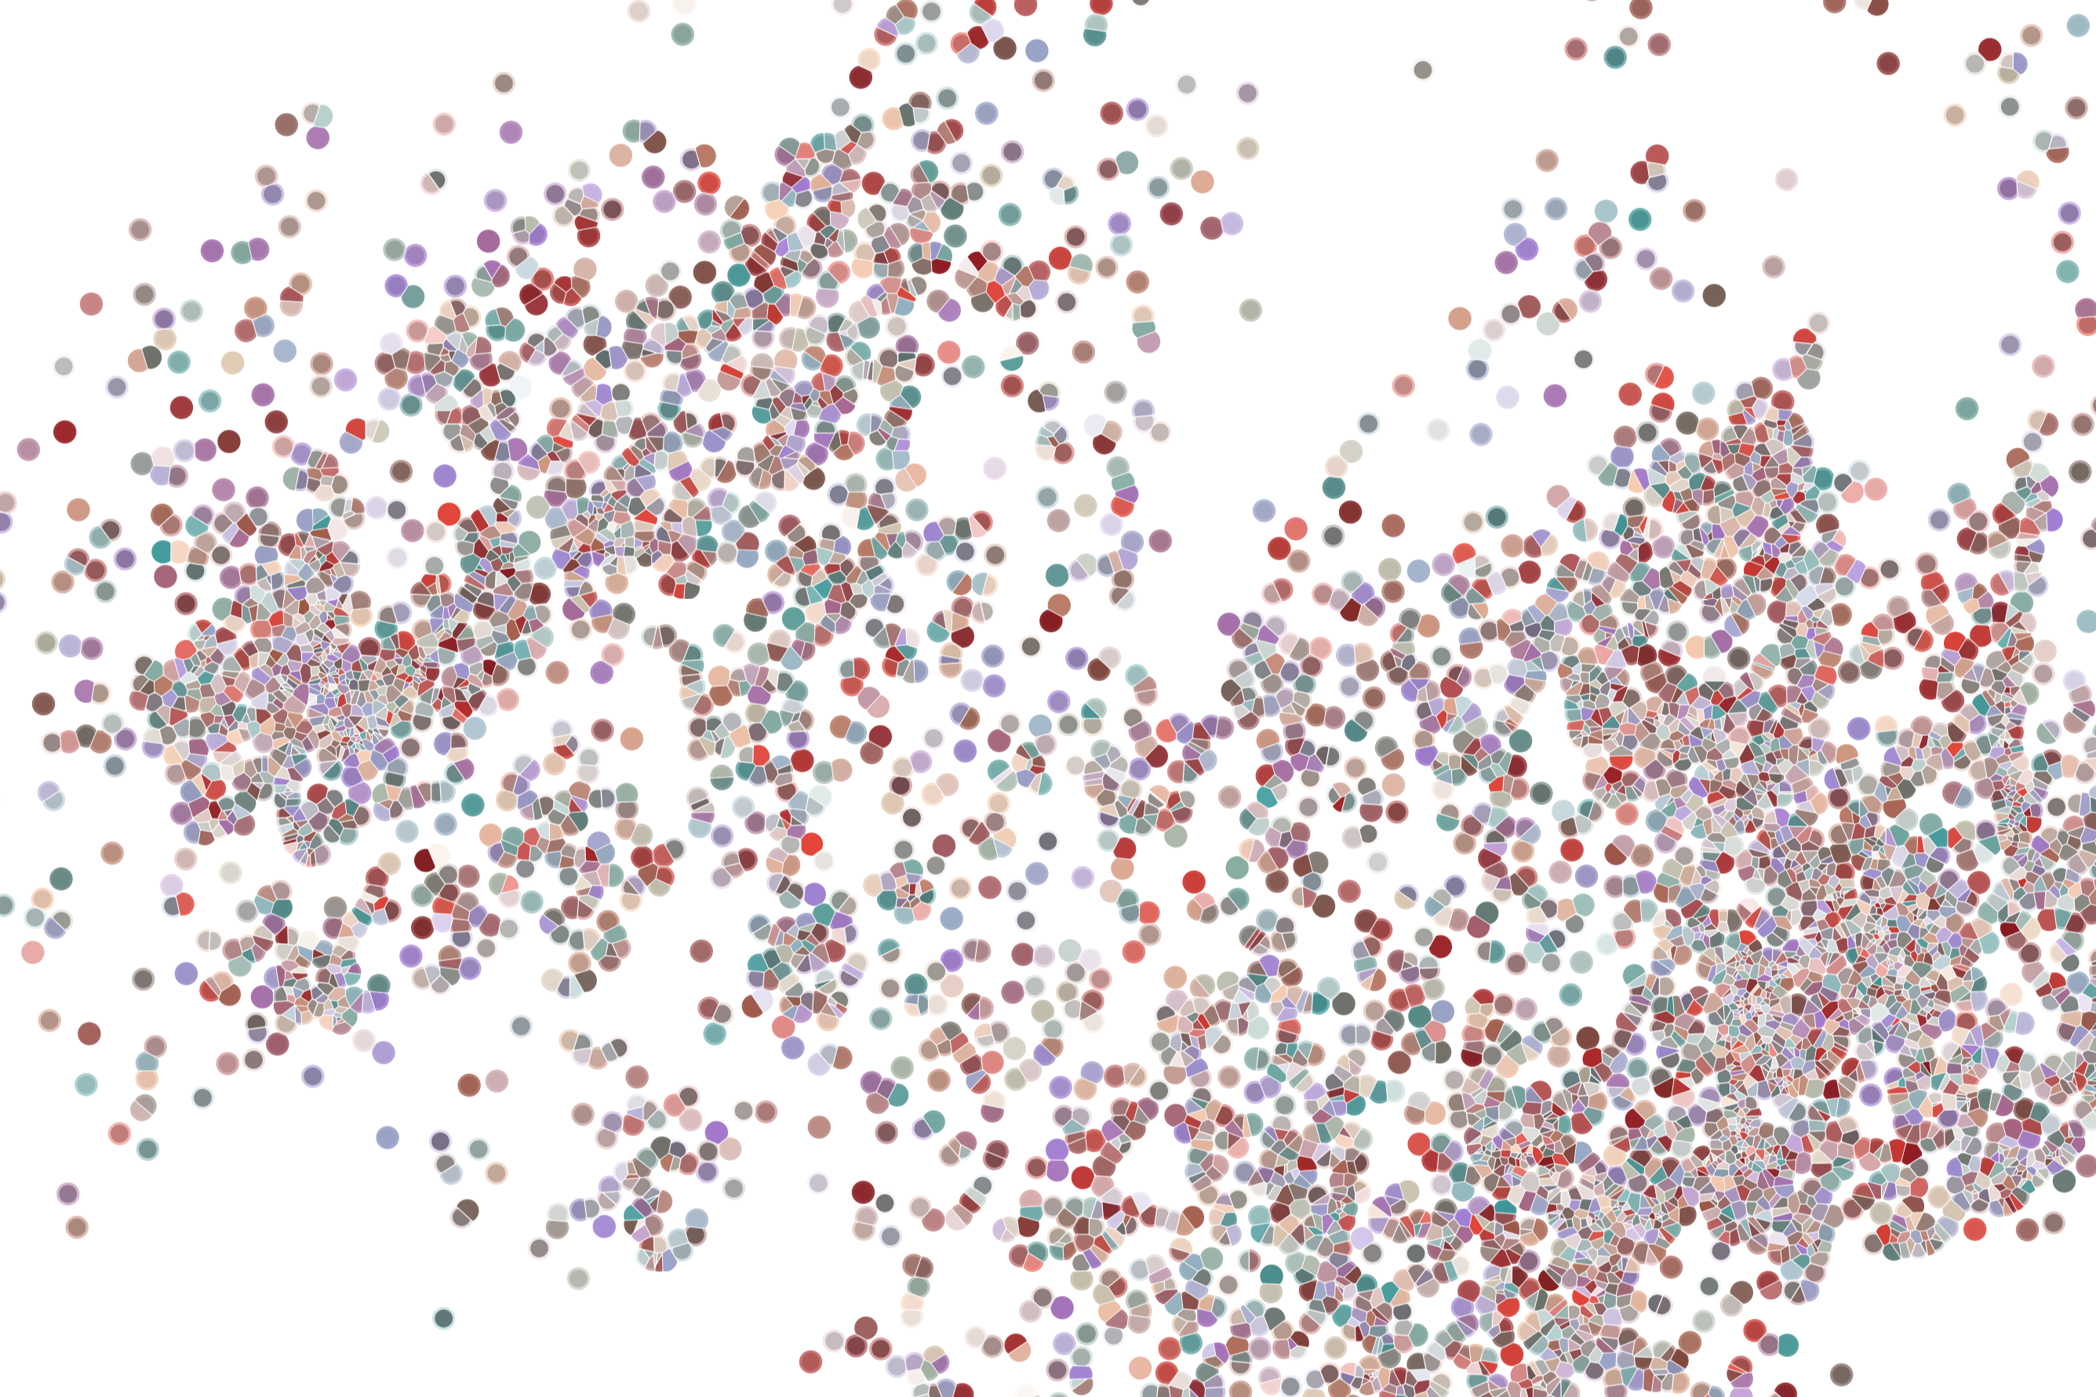
Improving package: Support for (raw) data, vignettes
Physalia course 2022
Instructor: Jacques Serizay
Notes:
Hello everybody and thank you for attending my presentation. I am going to talk about the project I recently started working on in the Spassky and Koszul labs, both located in Paris. This project focuses on the unusual cooption of the mitotic machinery to drive, not cell division but cell differentiation.

Slide 2
Standard package content
Write functions
myPackage/
R/
functions.R
utils.R
man/
myfunction.Rd tests/
testthat.R
testthat/
test-myfun.R
DESCRIPTION
README.md
NAMESPACE
NEWS
LICENSE
Document functions
Arguments
Imports
examples
> devtools::document()
> devtools::run_examples()
> devtools::test()
> devtools::load_all()
Test functions
Add example data
Add vignettes
Publish supporting website
Submit to Bioconductor

Slide 3
Standard package content
myPackage/
R/
functions.R
utils.R
man/
myfunction.Rd tests/
testthat.R
testthat/
test-myfun.R
DESCRIPTION
README.md
NAMESPACE
NEWS
LICENSE
myPackage/
R/
functions.R
utils.R
man/
myfunction.Rd tests/
testthat.R
testthat/
test-myfun.R
inst/
extdata/
<raw-data-file>
data/
<data>.Rda
vignettes/
myPackage.Rmd
DESCRIPTION
NAMESPACE
README.md
NEWS
LICENSE

Slide 4
Why providing data in your package?
Data shipped with your package are meant to:
Provide a means to run examples and demonstrate package functionalities in vignettes;
Directly enable analysis (in “data” packages)

Slide 5
Adding data to package
2 types of ”data”:
Raw: e.g. genomic files (bed, bigwig, bam, …) or other (tables, text files, …)
Processed: `.Rda `files, containing R objects to be loaded in memory in R.

Slide 6
Package size limits
Watch out! Your package should be < 5Mb. Genomic files (particularly) can expand in size very quickly. Be cautious!

Slide 7
Package size limits
Watch out! Your package should be < 5Mb. Genomic files (particularly) can expand in size very quickly. Be cautious!
This is a rather strict requirement for Bioconductor. Under only very few specific circumstances will the BioC core members allow you to exceed this (e.g. developing specific packages coordinated by the BioC team itself).

Slide 8
Package size limits
Watch out! Your package should be < 5Mb. Genomic files (particularly) can expand in size very quickly. Be cautious!
This is a rather strict requirement for Bioconductor. Under only very few specific circumstances will the BioC core members allow you to exceed this (e.g. developing specific packages coordinated by the BioC team itself).
Unrelated but still worth mentioning:
Don’t forget, Github never forgets! If you add a dataset and commit/push it to your Github repo, it will stay there forever. Even after deleting it, it will still be in your `.github` local folder and in Github memory (because you should be able to recover it back, since everything is reversible in Github). This usually results in enormous `.github` folders… Watch out for storage space!

Slide 9
Raw data
Raw data can be virtually any file, but it has to be relevant for the package development.
The main reason to include such files is when a key part of a package’s functionality is to act on an external file (e.g. `readr`, `vroom`, …).
Raw data is stored in `inst/extdata`.
myPackage/
R/
functions.R
utils.R
man/
myfunction.Rd tests/
testthat.R
testthat/
test-myfun.R
inst/
extdata/
<raw-data-file>
DESCRIPTION
NAMESPACE
README.md
NEWS
LICENSE

Slide 10
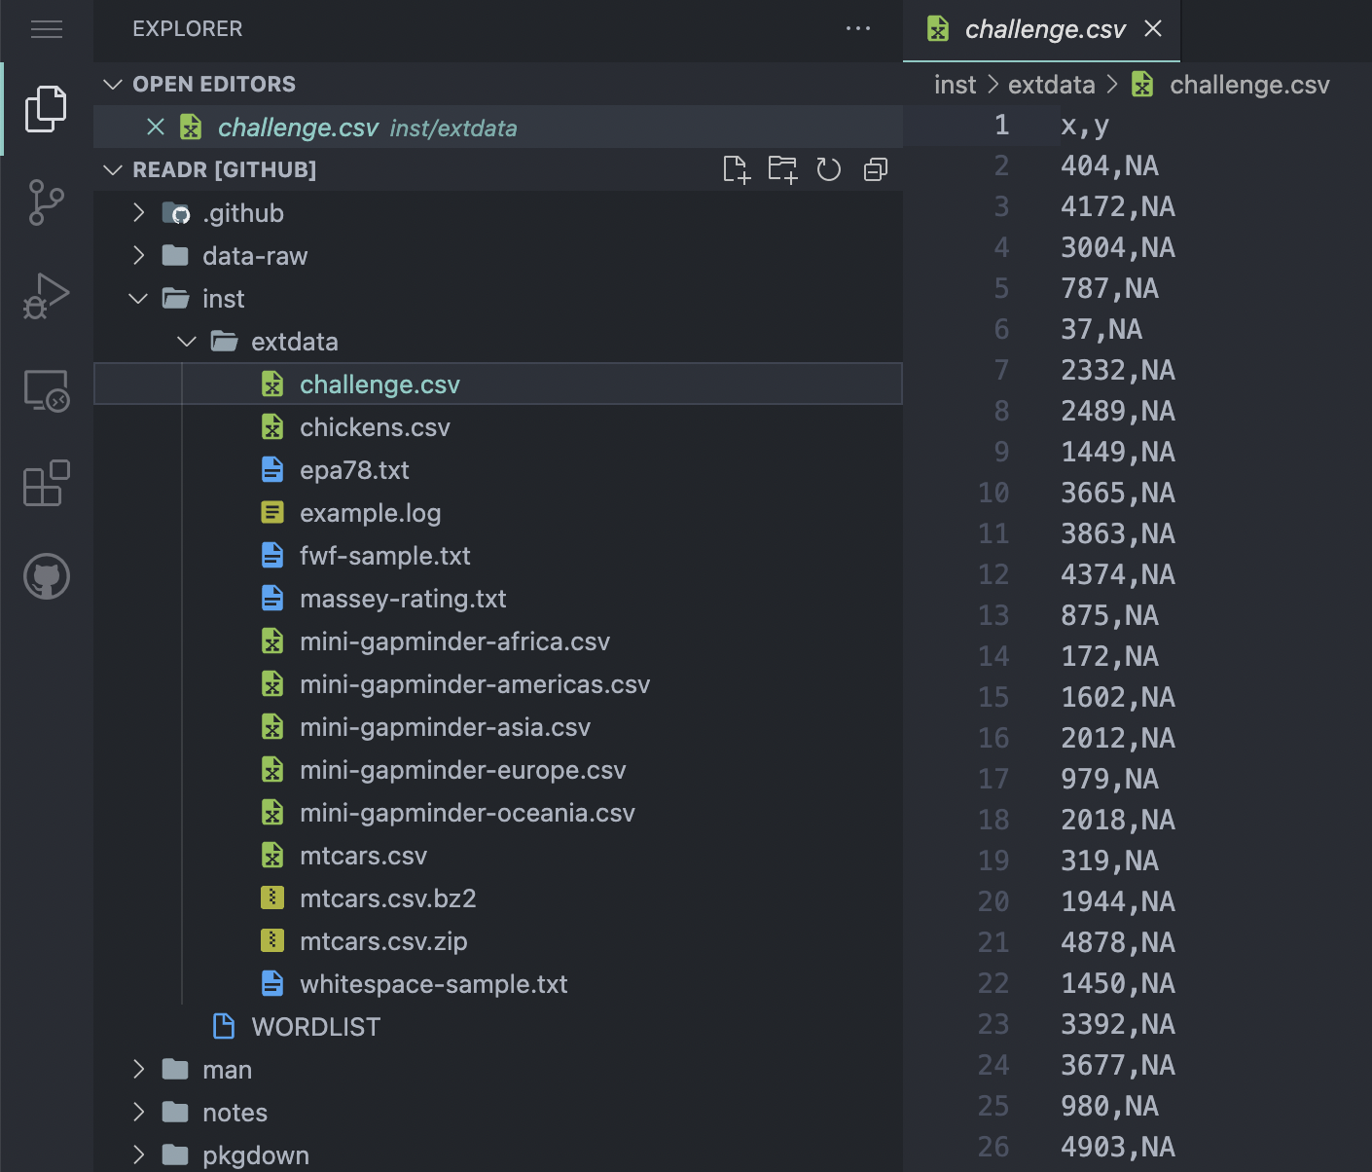
Raw data
Raw data can be virtually any file, but it has to be relevant for the package development.
The main reason to include such files is when a key part of a package’s functionality is to act on an external file (e.g. `readr`, `vroom`, …).
Raw data is stored in `inst/extdata`.

Slide 11
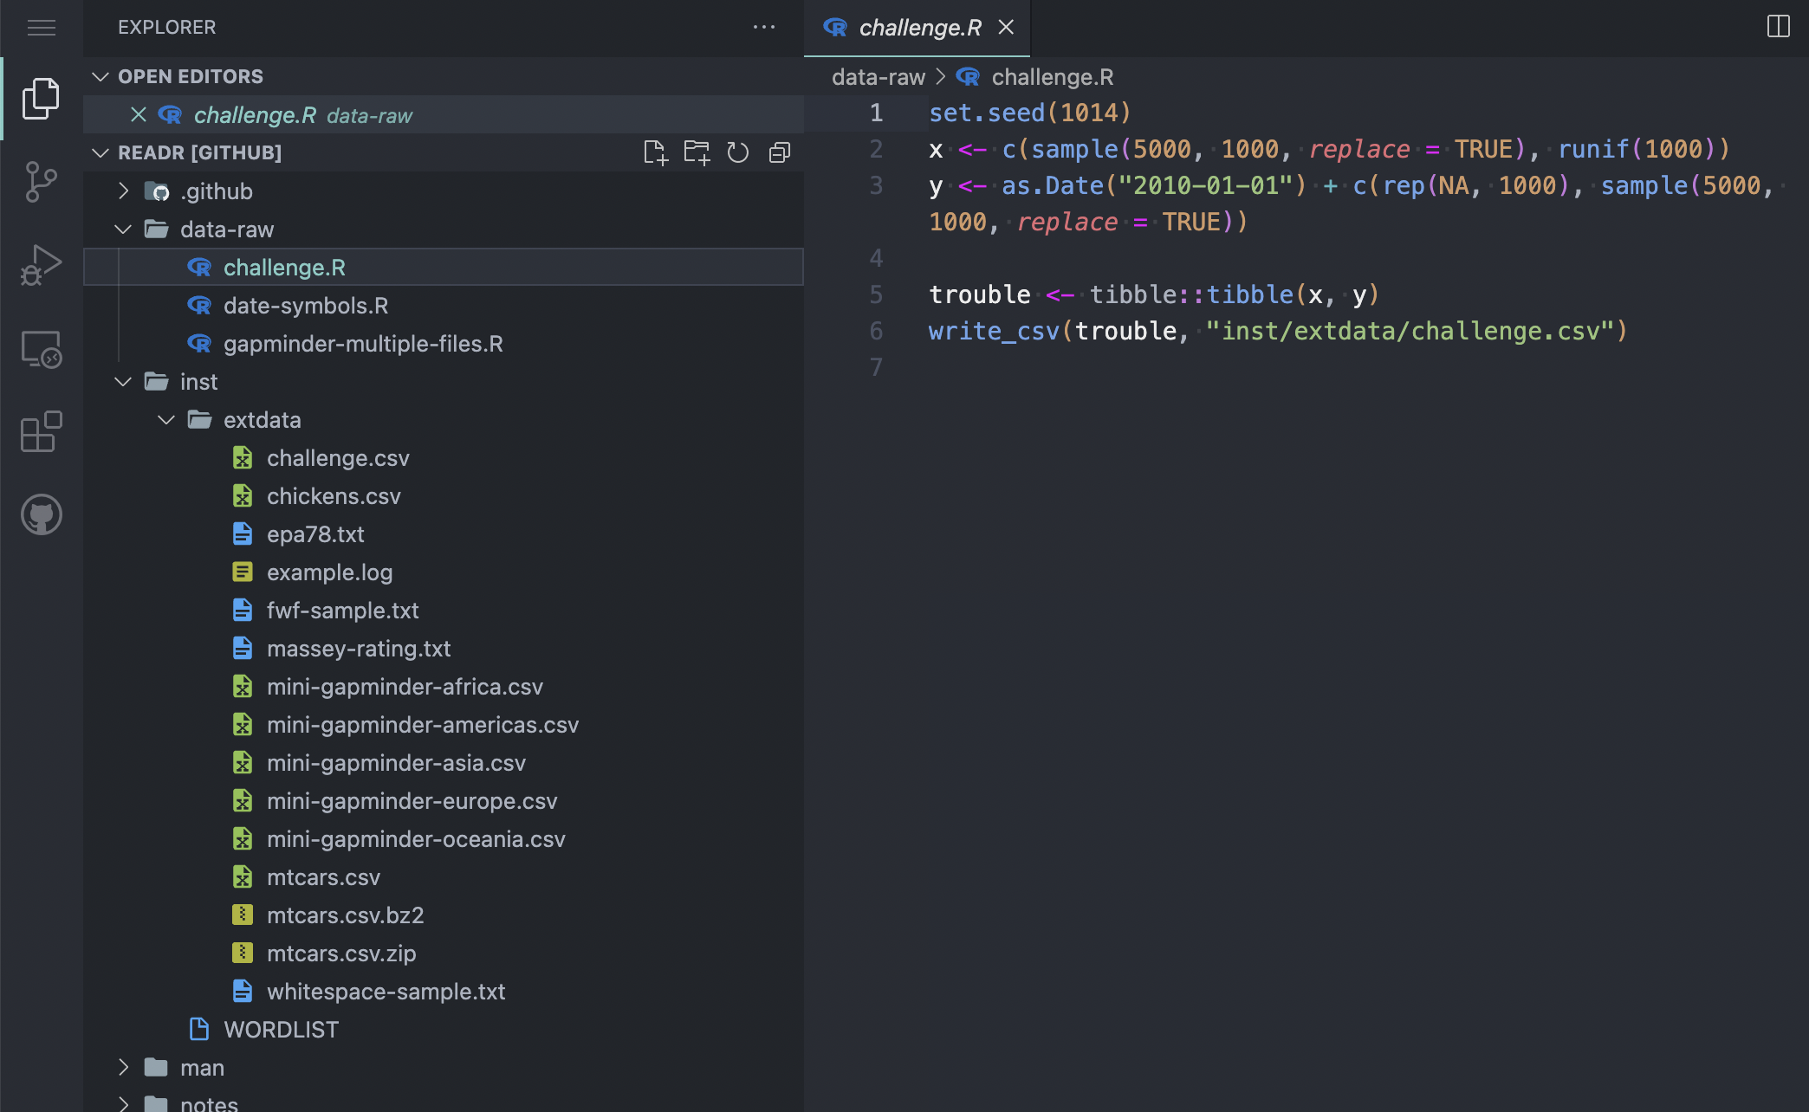
Raw data
It is good practice to document how raw data files were generated.
You can do it by adding a `data-raw` folder to the root of your package and add R files describing how the data was created.

Slide 12
Raw data
It is good practice to document how raw data files were generated.
You can do it by adding a `data-raw` folder to the root of your package and add R files describing how the data was created.
Of note, Bioconductor specifically prefers these files to be located in `inst/scripts/`: https://contributions.bioconductor.org/docs.html#doc-inst-script.

Slide 13
Use raw data
Raw data should generally not be read by the end-user.
Instead, it is a way for the package writer to describe how to import files.

Slide 14
Use raw data
Raw data should generally not be read by the end-user.
Instead, it is a way for the package writer to describe how to import files.
For this reason, raw data is generally only a toy dataset, a small subset of an actual dataset (e.g. only a single chromosome out of a whole genome, etc.)

Slide 15
Use raw data
Raw data should generally not be read by the end-user.
Instead, it is a way for the package writer to describe how to import files.
For this reason, raw data is generally only a toy dataset, a small subset of an actual dataset (e.g. only a single chromosome out of a whole genome, etc.).
For this reason as well, if your package deals with already existing file formats (e.g. bed, bam, bigwig, …), many BioC core packages (e.g. GenomicRanges, rtracklayer, Biostrings, ...) already provide toy datasets!!
Hosting all these raw data files has a cost (economical and environmental). Please, do check whether core packages can provide the type of files you’d need as a toy dataset.

Slide 16
Use raw data
The package writer can have access to their (or other packages’) raw data files using `system.file()`:
## List raw data files shipped with GenomicRanges
> system.file('extdata', package = 'GenomicRanges') |> list.files()
[1] "feature_frags.txt”
## Get full path to "feature_frags.txt”
> system.file('extdata', "feature_frags.txt", package = 'GenomicRanges')
[1] "/Users/jacques/Library/R/arm64/4.3/library/GenomicRanges/extdata/feature_frags.txt"

Slide 17
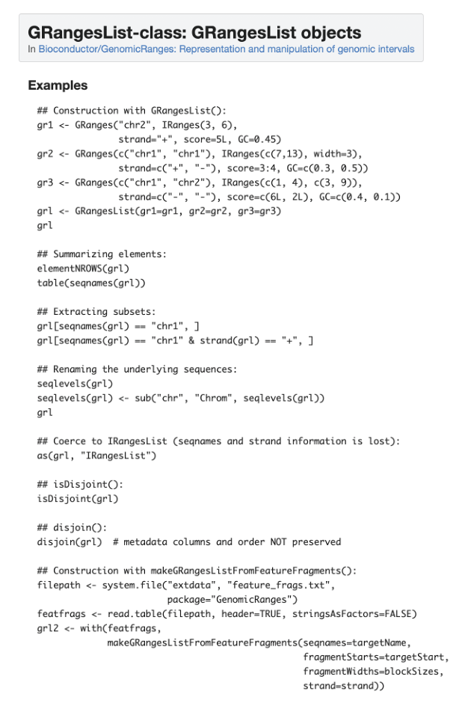
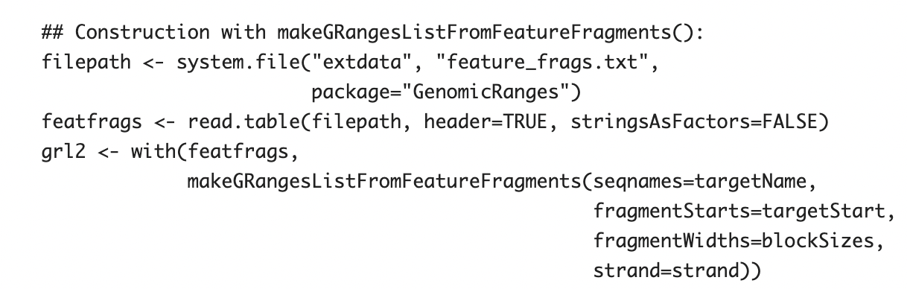
Use raw data
The package writer can have access to their (or other packages’) raw data files using `system.file()`:

Slide 18
Processed data
Processed data are stored in the `data/` folder.
myPackage/
R/
functions.R
utils.R
man/
myfunction.Rd tests/
testthat.R
testthat/
test-myfun.R
inst/
extdata/
<raw-data-file>
data/
mydata.rad
DESCRIPTION
NAMESPACE
README.md
NEWS
LICENSE

Slide 19
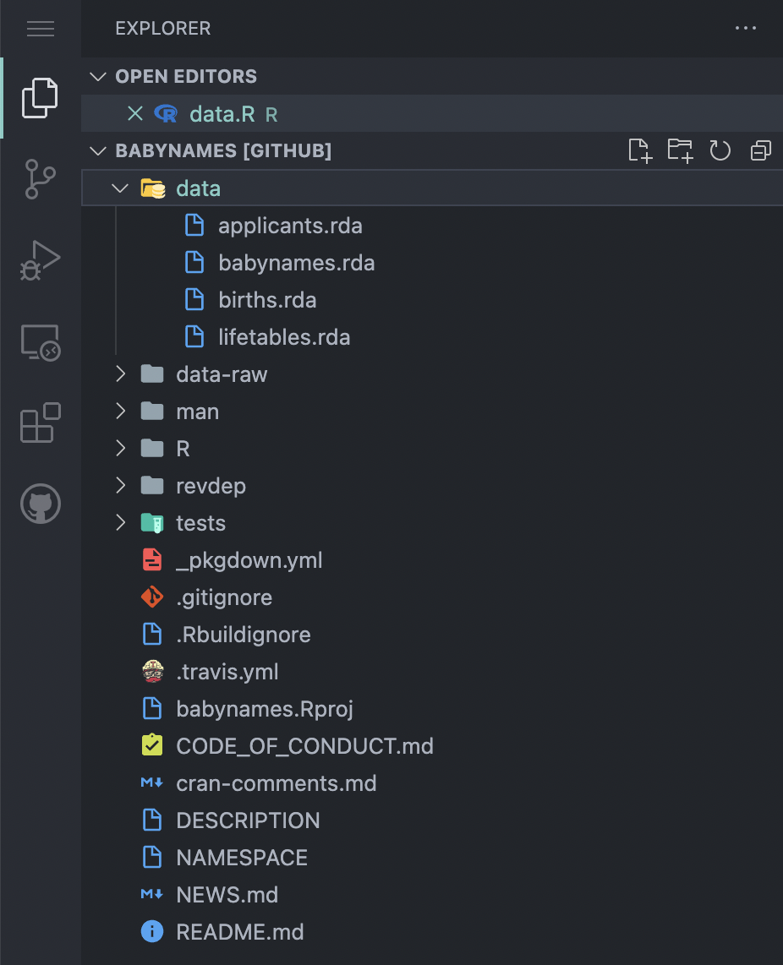
Processed data
Processed data are stored in the `data/` folder.

Slide 20
Processed data
Processed data are stored in the `data/` folder.
The best way to provide processed data in your package is through `usethis::use_data()`.
> chr <- vroom::vroom('HiCompute/testHiC.chr.tsv')
> chr
# A tibble: 17 x 4
contig length n_frags cumul_length
<chr> <dbl> <dbl> <dbl>
1 I 230218 1358 0
2 II 813184 4981 1358
3 III 316620 1948 6339
4 IV 1531933 9709 8287
5 V 576874 3484 17996
6 VI 270161 1734 21480
7 VII 1090940 6716 23214
8 VIII 562643 3405 29930
9 IX 439888 2756 33335
10 X 745751 4679 36091
11 XI 666816 4144 40770
12 XII 1078177 6728 44914
13 XIII 924431 5713 51642
14 XIV 784333 4847 57355
15 XV 1091291 6731 62202
16 XVI 948066 5814 68933
17 Mito 85779 160 74747
> usethis::use_data(chr)
v Saving 'chr' to 'data/chr.rda'
* Document your data (see 'https://r-pkgs.org/data.html')

Slide 21
Processed data
Processed data are stored in the `data/` folder.
The best way to provide processed data in your package is through `usethis::use_data()`.
Avoid at all costs creating the `data/` folder yourself. You should be able to use `usethis::use_data()` instead.
> chr <- vroom::vroom('HiCompute/testHiC.chr.tsv')
> chr
# A tibble: 17 x 4
contig length n_frags cumul_length
<chr> <dbl> <dbl> <dbl>
1 I 230218 1358 0
2 II 813184 4981 1358
3 III 316620 1948 6339
4 IV 1531933 9709 8287
5 V 576874 3484 17996
6 VI 270161 1734 21480
7 VII 1090940 6716 23214
8 VIII 562643 3405 29930
9 IX 439888 2756 33335
10 X 745751 4679 36091
11 XI 666816 4144 40770
12 XII 1078177 6728 44914
13 XIII 924431 5713 51642
14 XIV 784333 4847 57355
15 XV 1091291 6731 62202
16 XVI 948066 5814 68933
17 Mito 85779 160 74747
> usethis::use_data(chr)
v Saving 'chr' to 'data/chr.rda'
* Document your data (see 'https://r-pkgs.org/data.html')

Slide 22
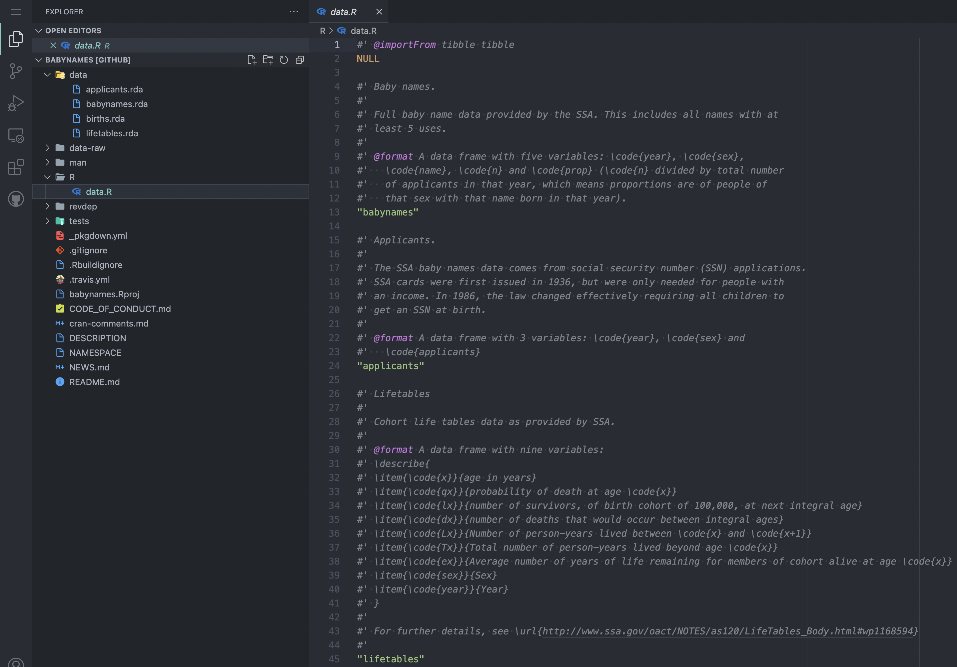
Processed data
Like anything else in your package, your data should be documented.
The recommended way is to do that in a `R/data.R` file

Slide 23
Processed data
Like anything else in your package, your data should be documented.
The recommended way is to do that in a `R/data.R` file

Slide 24
Processed data
Processed data are made readily available to your package end-users through the `data()` function.
> library(babynames)
> data(babynames)
> babynames
# A tibble: 1,924,665 × 5
year sex name n prop
<dbl> <chr> <chr> <int> <dbl>
1 1880 F Mary 7065 0.0724
2 1880 F Anna 2604 0.0267
3 1880 F Emma 2003 0.0205
4 1880 F Elizabeth 1939 0.0199
5 1880 F Minnie 1746 0.0179
6 1880 F Margaret 1578 0.0162
7 1880 F Ida 1472 0.0151
8 1880 F Alice 1414 0.0145
9 1880 F Bertha 1320 0.0135
10 1880 F Sarah 1288 0.0132
# … with 1,924,655 more rows
# i Use `print(n = ...)` to see more rows

Slide 25
Processed data
Processed data are made readily available to your package end-users through the `data()` function.
> data(lifetables)
> lifetables
# A tibble: 2,880 × 9
x qx lx dx Lx Tx ex sex year
<dbl> <dbl> <dbl> <dbl> <dbl> <dbl> <dbl> <fct> <dbl>
1 0 0.146 100000 14596 90026 5151511 51.5 M 1900
2 1 0.0328 85404 2803 84003 5061484 59.3 M 1900
3 2 0.0163 82601 1350 81926 4977482 60.3 M 1900
4 3 0.0105 81251 855 80824 4895556 60.2 M 1900
5 4 0.00875 80397 703 80045 4814732 59.9 M 1900
6 5 0.00628 79693 501 79443 4734687 59.4 M 1900
7 6 0.00462 79193 366 79010 4655244 58.8 M 1900
8 7 0.00326 78827 257 78698 4576234 58.0 M 1900
9 8 0.00256 78569 201 78469 4497536 57.2 M 1900
10 9 0.00203 78368 159 78288 4419068 56.4 M 1900
# … with 2,870 more rows
# i Use `print(n = ...)` to see more rows

Slide 26
Vignettes
Vignettes are extensive (comprehensive) walkthrough of your package functionalities.

Slide 27
Vignettes
Vignettes are extensive (comprehensive) walkthrough of your package functionalities.
They live in the `vignettes/` folder (duh 🙄) .
myPackage/
R/
functions.R
utils.R
man/
myfunction.Rd tests/
testthat.R
testthat/
test-myfun.R
inst/
extdata/
<raw-data-file>
data/
<data>.Rda
vignettes/
myPackage.Rmd
DESCRIPTION
NAMESPACE
README.md
NEWS
LICENSE

Slide 28
Vignettes
Vignettes are extensive (comprehensive) walkthrough of your package functionalities.
They live in the `vignettes/` folder (duh 🙄) .
You can create a vignette boilerplate with either:
usethis::use_vignette(’<YOUR-PACKAGE>’)
biocthis::use_bioc_vignette(’<YOUR-PACKAGE>’)

Slide 29
Vignettes
Vignettes are extensive (comprehensive) walkthrough of your package functionalities.
They live in the `vignettes/` folder (duh 🙄) .
You can create a vignette boilerplate with either:
usethis::use_vignette(’<YOUR-PACKAGE>’)
biocthis::use_bioc_vignette(’<YOUR-PACKAGE>’)
You are not limited to a single vignette. However, you must provide at least one, which should be named <YOUR-PACKAGE>.Rmd.

Slide 30
Vignettes
Vignettes are extensive (comprehensive) walkthrough of your package functionalities.
They live in the `vignettes/` folder (duh 🙄) .
You can create a vignette boilerplate with either:
usethis::use_vignette(’<YOUR-PACKAGE>’)
biocthis::use_bioc_vignette(’<YOUR-PACKAGE>’)
You are not limited to a single vignette. However, you must provide at least one, which should be named <YOUR-PACKAGE>.Rmd.
Be as thorough as possible to describe all your package functionalities.

Slide 31
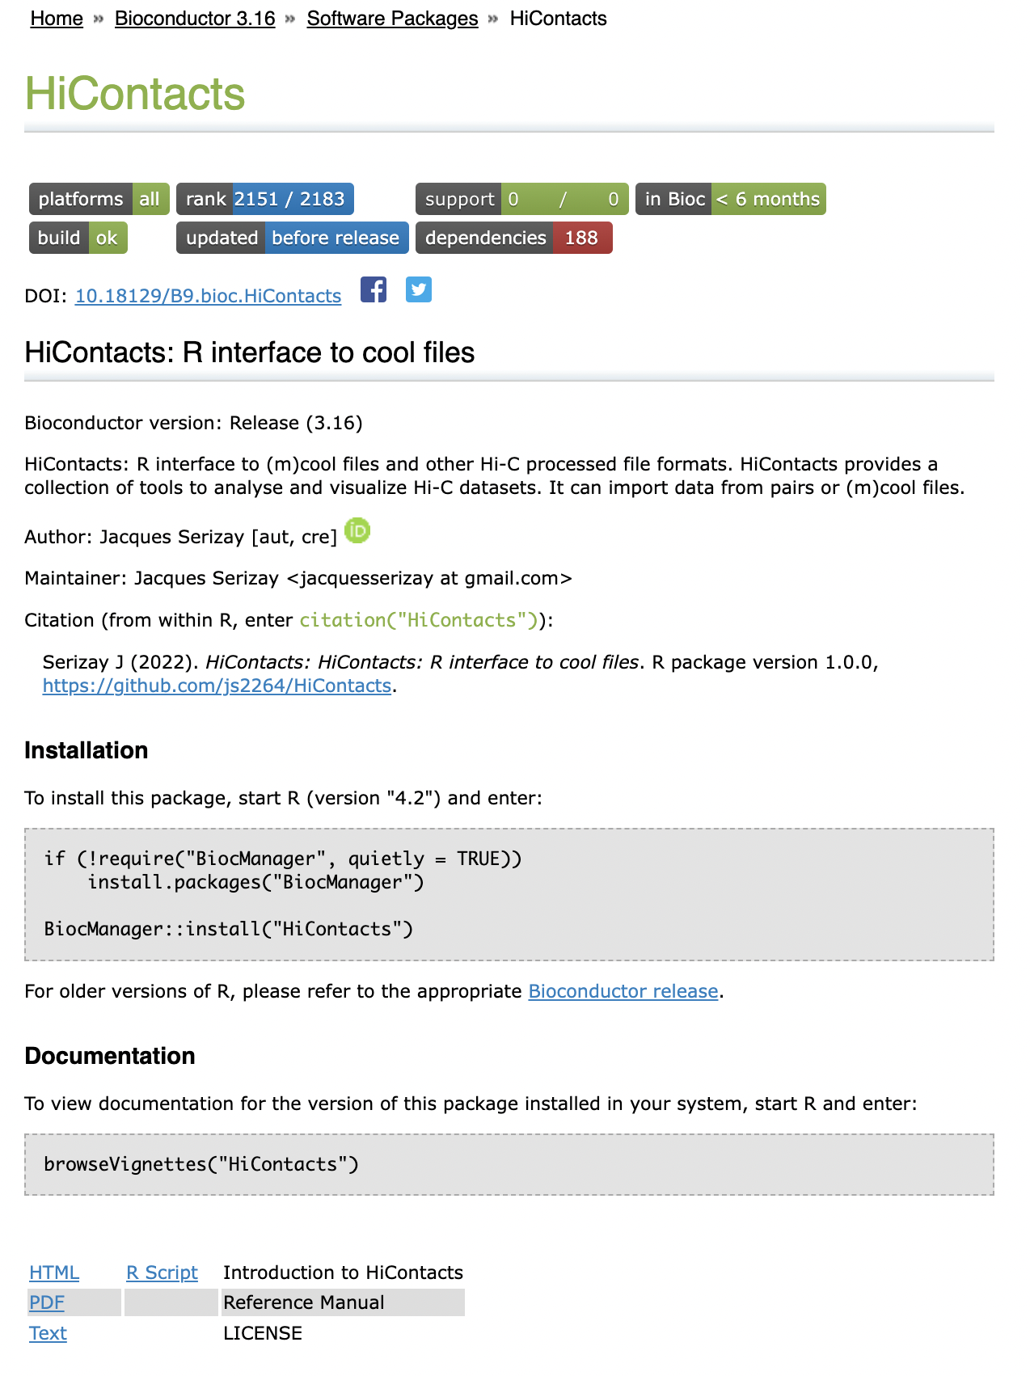
Vignettes
Once your package is accepted by BioC, your vignette will be compiled by the Bioconductor Single Package Builder into an HTML page, accessible through your package webpage.

Slide 32
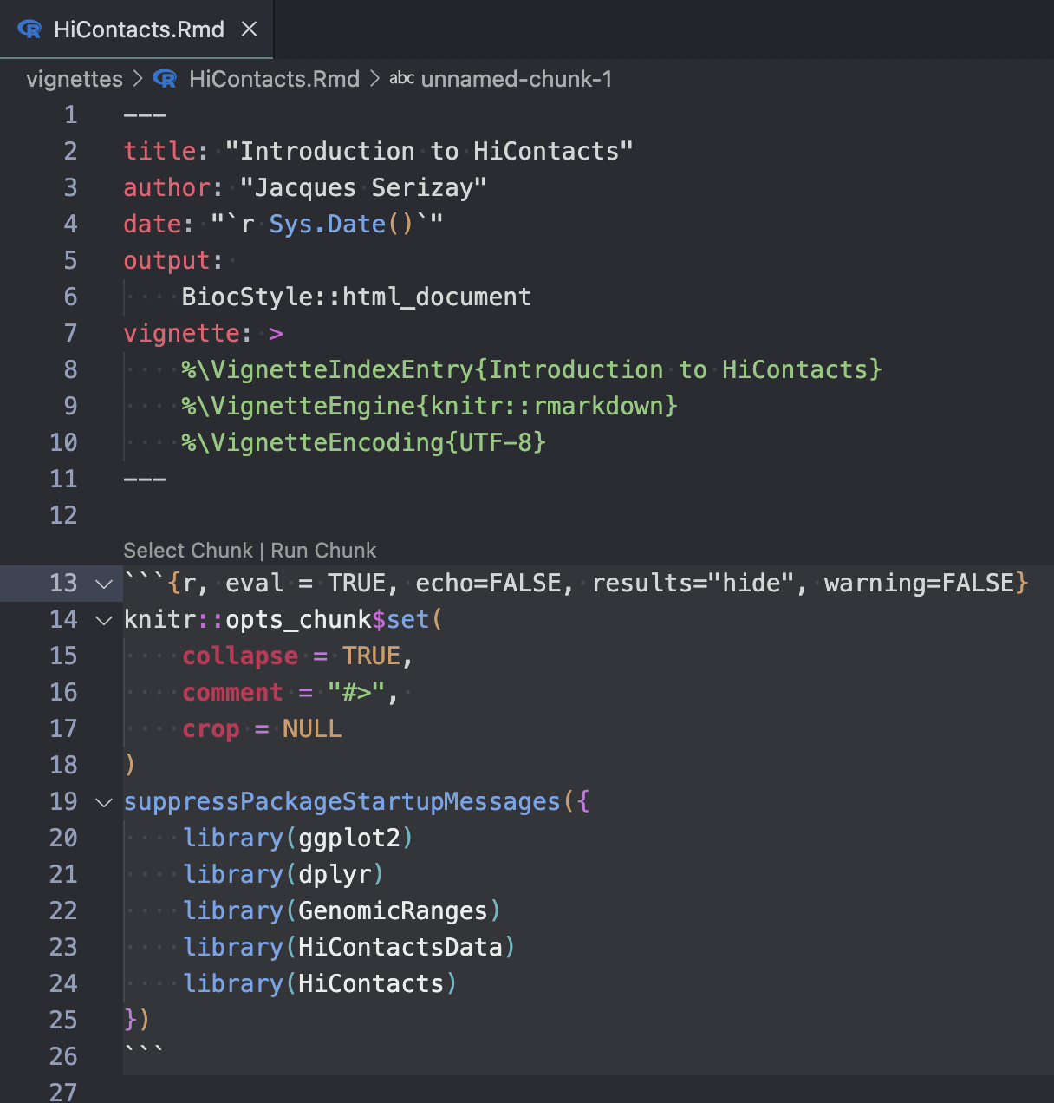
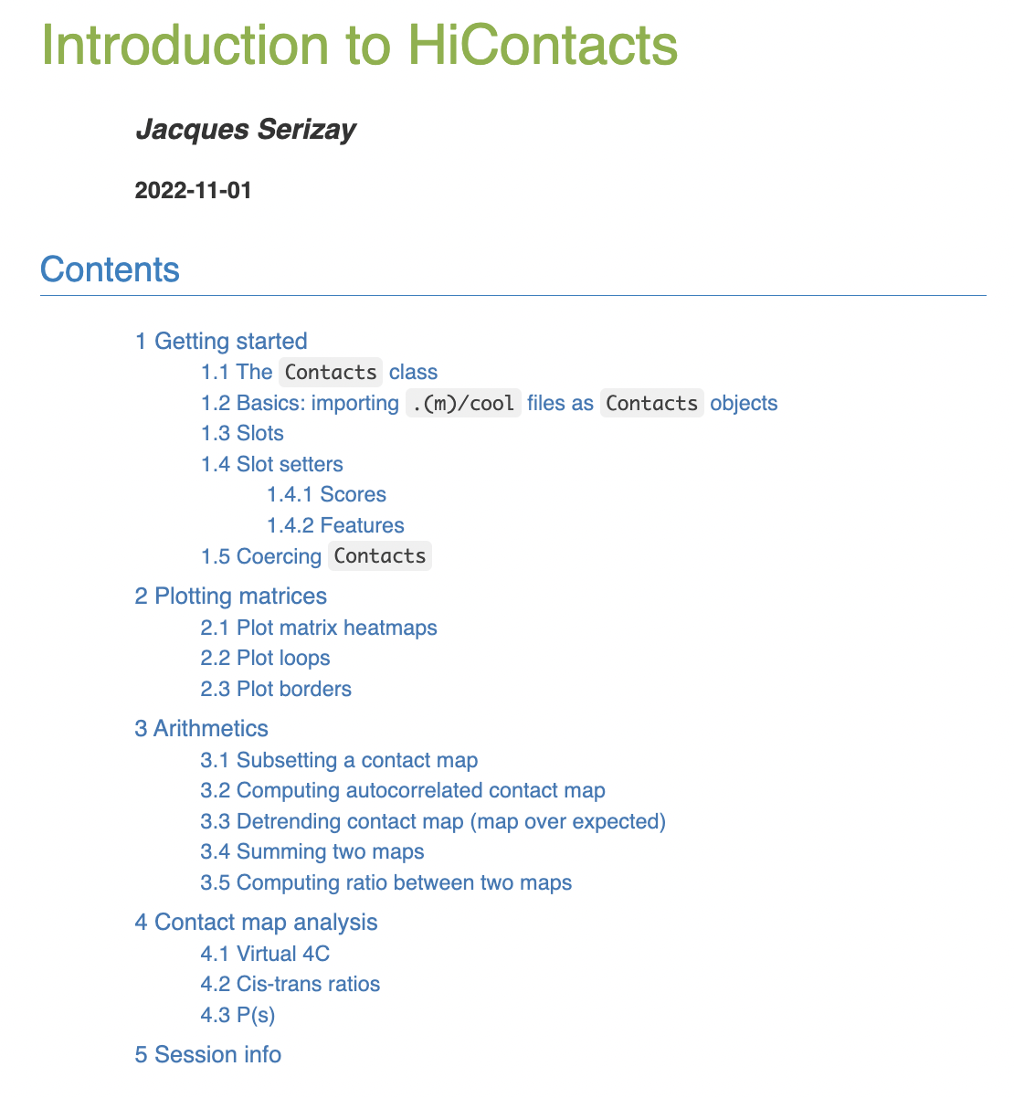
Vignettes

Slide 33
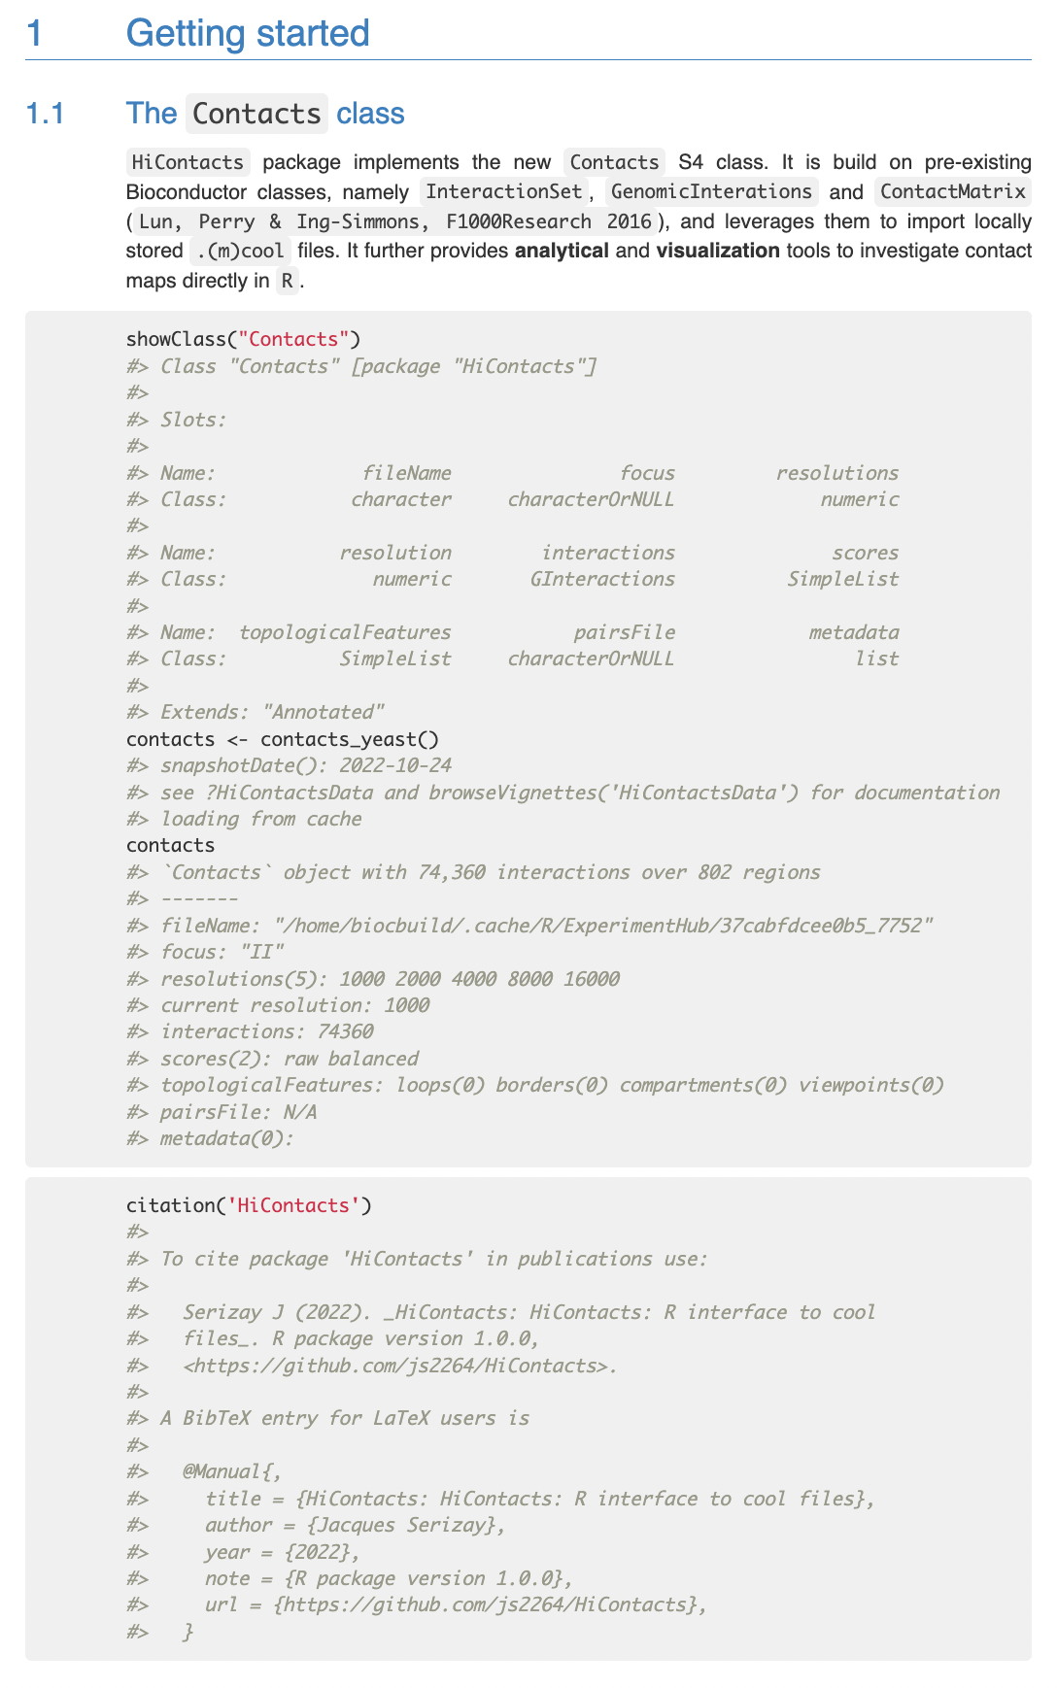
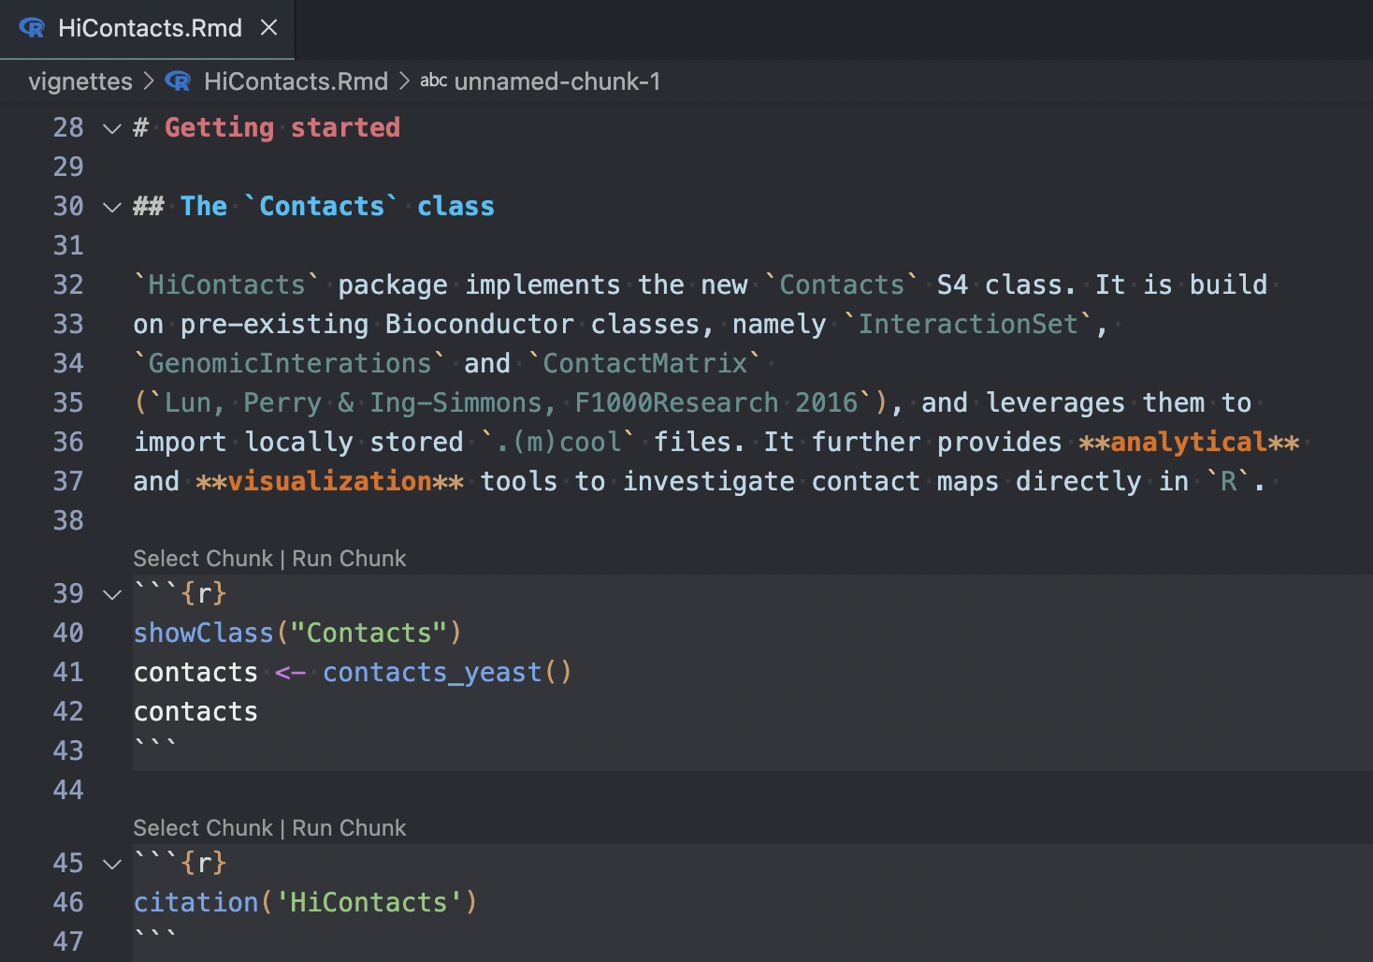
Vignettes

Slide 34
Vignettes
This means all the code in a vignette must work!

Slide 35
Standard package content
myPackage/
R/
functions.R
utils.R
man/
myfunction.Rd tests/
testthat.R
testthat/
test-myfun.R
inst/
extdata/
<raw-data-file>
data/
<data>.Rda
vignettes/
myPackage.Rmd
DESCRIPTION
NAMESPACE
README.md
NEWS
LICENSE
myPackage/
R/
functions.R
utils.R
man/
myfunction.Rd tests/
testthat.R
testthat/
test-myfun.R
DESCRIPTION
README.md
NAMESPACE
NEWS
LICENSE

